Slide 1
2CEIT502 Software Engineering
GANPAT UNIVERSITY
U. V. PATEL COLLEGE OF ENGINEERING
UNIT 8
Unified Modelling Language (UML)
Prepared by: Prof. Y. J. Prajapati (Asst. Prof in IT Dept. , UVPCE)

Slide 2
Outline
Overview of object oriented concepts
Advantage of OOD
UML diagrams
Use Case Diagram
Class Diagram
Sequence Diagram
collaboration Diagram
Activity Diagram
State chart Diagram

Slide 3
Overview of object oriented concepts
What is Object-Orientation?
It means that we organize software as a collection of discrete objects that incorporate both data structure and behavior
Object = Data structure + Behavior
(attributes) (operations)
Four aspects of OO approach (characteristics) :
Identity
Classification
Inheritance
polymorphism
Identity
It means that data is quantized into discrete, distinguishable entities called objects
Ex. White queen in chess
Object can be concrete, such as a file in a file system, or conceptual, such as a scheduling policy in a multiprogramming operating system
Each object has its own inherent identity
Two objects are different even if the attribute values are same

Slide 4
Overview of object oriented concepts
Classification
Objects with same data structure and behavior are grouped together into a class
A class is an abstraction that describes a properties important to an application and ignores the rest
Any choice of classes is arbitrary and depends on the application
Each class describes infinite set of individual objects
Object is said to be instance of its class
Inheritance
It is the sharing of attributes and operations among classes based on a hierarchical relationship
A super class has general information that subclass refine and elaborate
Each subclass inherits all features of its super class and adds its own unique features
Subclasses need not to repeat the features of the super class
Ex. Scrolling window and Fixed window are subclasses of Window class

Slide 5
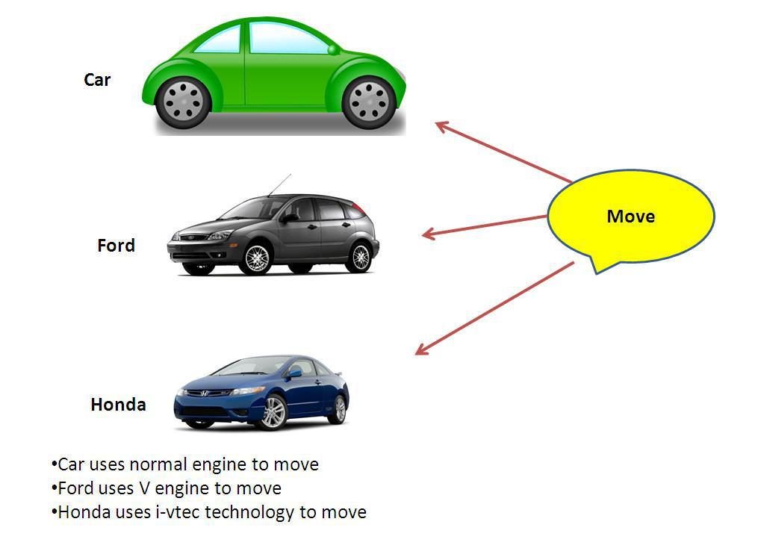
Overview of object oriented concepts
Polymorphism
The same operation behave differently for different classes
Ex. Move operation for a pawn and the queen in a chess game
An operation is a procedure or transformation that an object performs
An implementation of the operation by a specific class is called a method

Slide 6
Advantage of OOD,
Faster Development
Reuse of Previous work
Increased Quality
Modular Architecture
Client/Server Applications
Better Mapping to the Problem Domain

Slide 7
Unified modelling language(UML)
What is UML?
UML stands for “Unified Modeling Language”
It is a industry-standard graphical language for specifying, visualizing, constructing, and documenting the artifacts of software systems
The UML uses mostly graphical notations to express the OO analysis and design of software projects.
Simplifies the complex process of software design
Why UML for Modeling
Use graphical notation to communicate more clearly than natural language (imprecise) and code(too detailed).
Help acquire an overall view of a system.
UML is not dependent on any one language or technology.

Slide 8
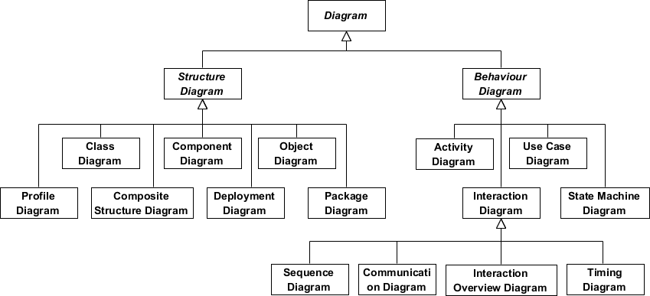
UML diagrams

Slide 9
UML diagrams
Structure diagrams show the static structure of the system and its parts on different abstraction and implementation levels and how they are related to each other. The elements in a structure diagram represent the meaningful concepts of a system, and may include abstract, real world and implementation concepts, there are seven types of structure diagram as follows:
Class Diagram
Component Diagram
Deployment Diagram
Object Diagram
Package Diagram
Composite Structure Diagram
Profile Diagram
Behavior diagrams show the dynamic behavior of the objects in a system, which can be described as a series of changes to the system over time, there are seven types of behavior diagrams as follows:
Use Case Diagram
Activity Diagram
State Machine Diagram
Sequence Diagram
Communication Diagram
Interaction Overview Diagram
Timing Diagram

Slide 10
Use Case Diagram
A use case diagram is a dynamic or behavior diagram in UML. Use case diagrams model the functionality of a system using actors and use cases. Use cases are a set of actions, services, and functions that the system needs to perform
Purposes of use case diagrams
Used to gather the requirements of a system.
Used to get an outside view of a system.
Identify the external and internal factors influencing the system.
Show the interaction among the requirements are actors.
Use case diagrams are used to visualize, specify, construct, and document the (intended) behavior of the system, during requirements capture and analysis.
Provide a way for developers, domain experts and end-users to Communicate.
Serve as basis for testing.
Use case diagrams contain use cases, actors, and their relationships.

Slide 11

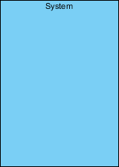
Use Case Diagram
Actor: A role that a user plays with respect to the system, including human users and other systems. e.g., inanimate physical objects (e.g. robot); an external system that needs some information from the current system.
Use case: A set of scenarios that describing an interaction between a user and a system, including alternatives.
System boundary: rectangle diagram representing the boundary between the actors and the system.
Association: Communication between an actor and a use case; Represented by a solid line.

Slide 12
Use Case Diagram
A use case describes a sequence of actions a system performs to yield an observable result or value to a particular actor
Naming convention = verb + noun (or) verb + noun-phrase,
e.g. withdraw cash
A good use case should:
Describe a sequence of transactions performed by a system that produces a measurable result (goal) for a particular actor
Describe the behavior expected of a system from a user's perspective
Enable the system analyst to understand and model a system from a high-level business viewpoint
Represent the interfaces that a system makes visible to the external entities and the interrelationships between the actors and the system
Identifying use cases for a system
What are the tasks of each actor?
Will any actor create, store, change, remove, or read the information?
Will any actor need to inform the system about the sudden, external changes?
Does any actor need to informed about certain occurrences in the system?
What use cases will support and maintain the system?
Can all functional requirements be performed by the use cases?

Slide 13
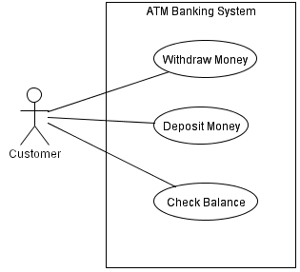
Example
System name
Actor
Use-case
System boundary
Association

Slide 14
Use Case Relationships
INCLUDES. The includes relationship (also called uses relationship) describes the situation in which a use case contains behavior that is common to more than one use case. In other words, the common use case is included in the other use cases. A dotted arrow that points to the common use case indicates the includes relationship. An example would be a use case Pay Student Fees that is included in Enroll in Course and Arrange Housing, because in both cases students must pay their fees. This may be used by several use cases. The arrow points toward the common use case.
EXTENDS. The extends relationship describes the situation in which one use case possesses the behavior that allows the new use case to handle a variation or exception from the basic use case. For example, the extended use case Student Health Insurance extends the basic use case Pay Student Fees. The arrow goes from the extended to the basic use case.
GENERALIZES. The generalizes relationship implies that one thing is more typical than the other thing. This relationship may exist between two actors or two use cases. For example, a Part-Time Student generalizes a Student. Similarly, some of the university employees are professors. The arrow points to the general thing.

Slide 15
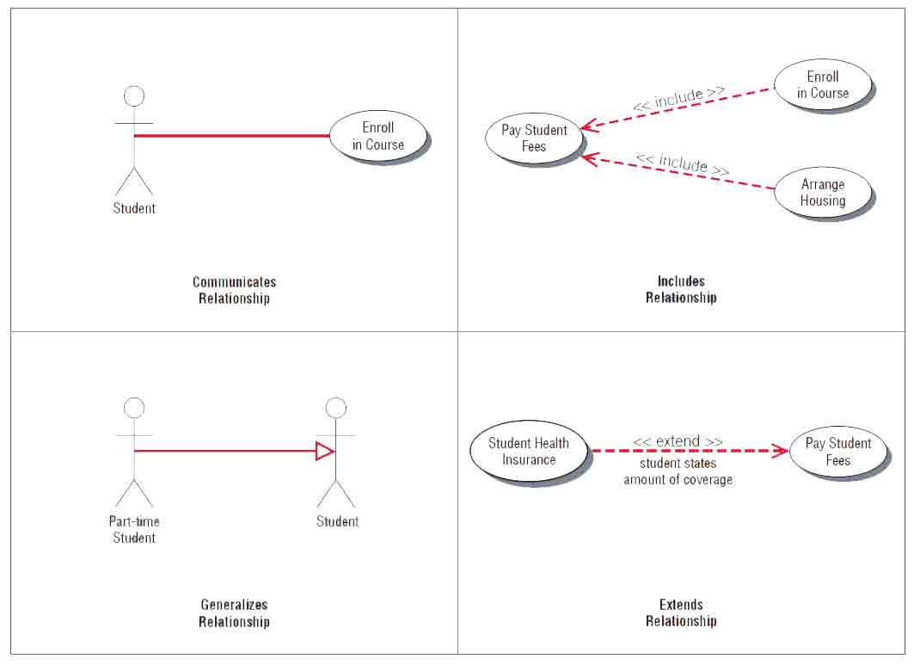
Example

Slide 16
Class Diagram
The UML Class diagram is a graphical notation used to construct and visualize object oriented systems. A class diagram in the Unified Modeling Language (UML) is a type of static structure diagram that describes the structure of a system by showing the system's:
classes,
their attributes,
operations (or methods),
and the relationships among objects.
Class diagram is a static diagram. It represents the static view of an application.
Purpose of Class Diagrams
Analysis and design of the static view of an application.
Describe responsibilities of a system.
Base for component and deployment diagrams.
Forward and reverse engineering.

Slide 17
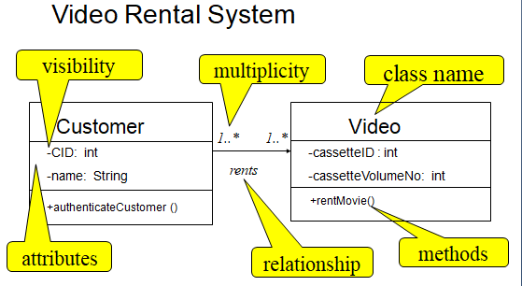
Class Diagram
UML Representation of Class
Class Name
Attributes of Class
Operations/methods of Class

Slide 18
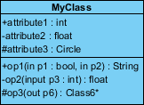
Class Diagram
Visibility of Attributes and Operations
In object-oriented design, there is a notation of visibility for attributes and operations. UML identifies four types of visibility: public, protected, private, and package.
The +, -, # and ~ symbols before an attribute and operation name in a class denote the visibility of the attribute and operation.
+ denotes public attributes or operations
- denotes private attributes or operations
# denotes protected attributes or operations
~ denotes package attributes or operations
Class Visibility Example
Access Right | public (+) | private (-) | protected (#) | Package (~)
Members of the same class | yes | yes | yes | yes
Members of derived classes | yes | no | yes | yes
Members of any other class | yes | no | no | in same package

Slide 19
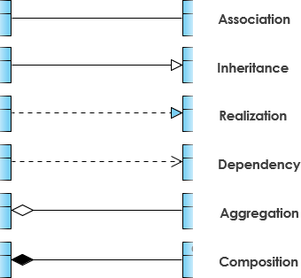
Class Diagram
Relationships among Classes
Represents a connection between multiple classes or a class and itself
basic categories:
association relationships
generalization relationships
aggregation relationships
Composition relationships

Slide 20
Class Diagram
Multiplicity
How many objects of each class take part in the relationships and multiplicity can be expressed as:
Exactly one - 1
Zero or one - 0..1
Many - 0..* or *
One or more - 1..*
Exact Number - e.g. 3..4 or 6
Or a complex relationship - e.g. 0..1, 3..4, 6.* would mean any number of objects other than 2 or 5

Slide 21
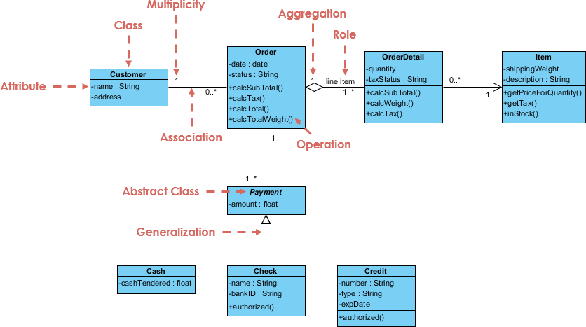
Example

Slide 22
Sequence Diagrams
A sequence diagram simply depicts interaction between objects in a sequential order i.e. the order in which these interactions take place.
We can also use the terms event diagrams or event scenarios to refer to a sequence diagram. Sequence diagrams describe how and in what order the objects in a system function.
These diagrams are widely used by businessmen and software developers to document and understand requirements for new and existing systems.
Sequence diagrams are used to capture the order of messages flowing from one object to another.
The purpose of interaction diagram is −
To capture the dynamic behaviour of a system.
To describe the message flow in the system.
To describe the structural organization of the objects.
To describe the interaction among objects.

Slide 23
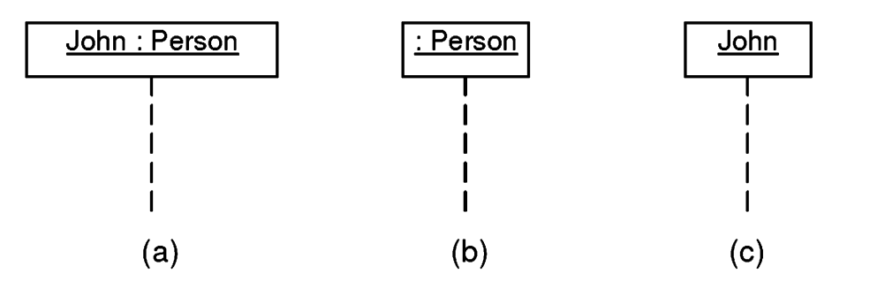
Sequence Diagram Notations
Lifelines – A lifeline is a named element which depicts an individual participant in a sequence diagram. So basically each instance in a sequence diagram is represented by a lifeline. Lifeline elements are located at the top in a sequence diagram.

Slide 24
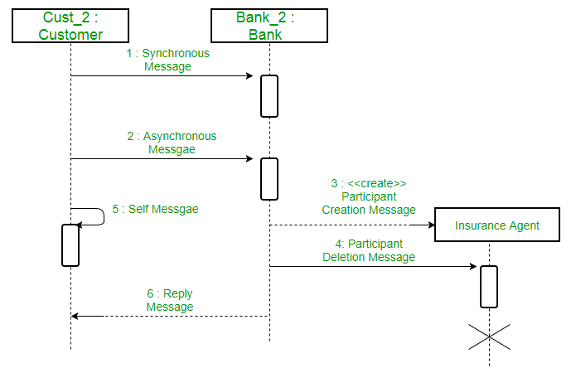
Sequence Diagram Notations
Messages– Communication between objects is depicted using messages. The messages appear in a sequential order on the lifeline. We represent messages using arrows. Lifelines and messages form the core of a sequence diagram.

Slide 25

Sequence Diagram Notations
Activations
A thin rectangle on a lifeline) represents the period during which an element is performing an operation.
The top and the bottom of the of the rectangle are aligned with the initiation and the completion time respectively

Slide 26
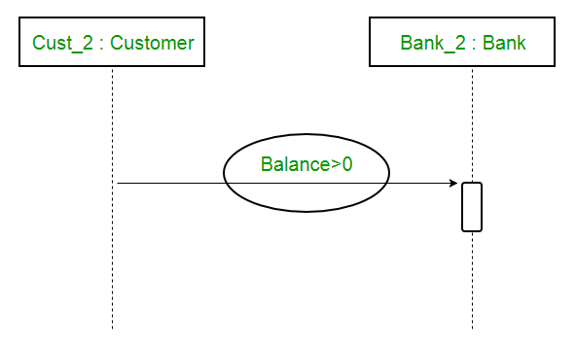
Sequence Diagram Notations
Guards – To model conditions we use guards in UML. They are used when we need to restrict the flow of messages on the pretext of a condition being met. Guards play an important role in letting software developers know the constraints attached to a system or a particular process.

Slide 27
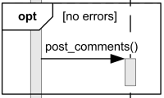
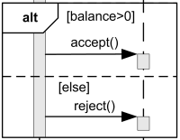
Sequence Diagram Notations
Combined Fragment
Alternatives
The interaction operator alt means that the combined fragment represents a choice or alternatives of behavior.
Option
The interaction operator opt means that the combined fragment represents a choice of behavior where either the (sole) operand happens or nothing happens.

Slide 28
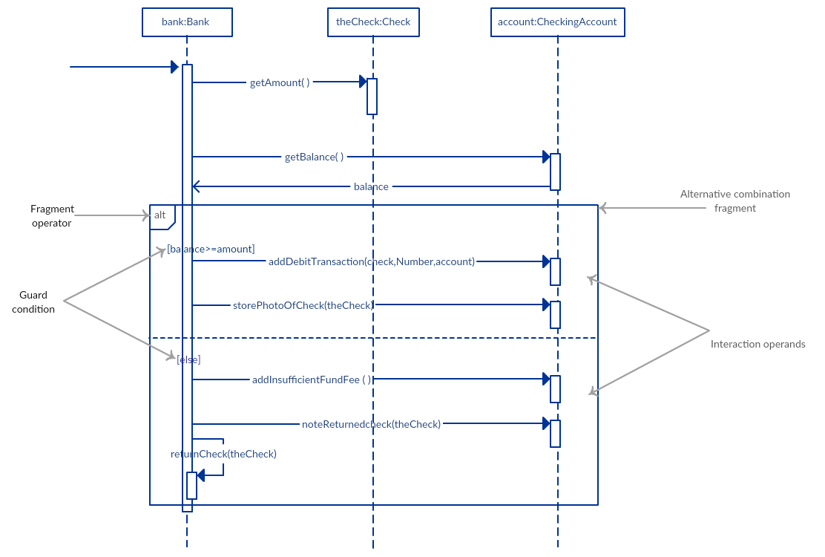
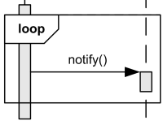
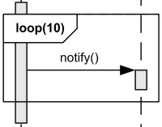
Sequence Diagram Notations
Loop
The interaction operator loop means that the combined fragment represents a loop. The loop operand will be repeated a number of times.

Slide 29
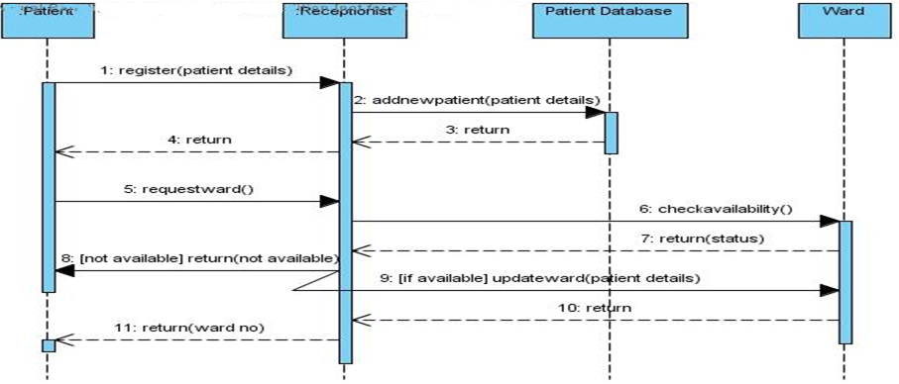
Example :Sequence Diagram for Patient Admit / Registration

Slide 30
Collaboration Diagram
The collaboration diagram is used to show the relationship between the objects in a system. Both the sequence and the collaboration diagrams represent the same information but differently.
An object consists of several features. Multiple objects present in the system are connected to each other. The collaboration diagram, which is also known as a communication diagram, is used to portray the object's architecture in the system.
Notations of a Collaboration Diagram
Objects: The representation of an object is done by an object symbol with its name and class underlined, separated by a colon.
In the collaboration diagram, objects are utilized in the following ways:
The object is represented by specifying their name and class.
It is not mandatory for every class to appear.
A class may constitute more than one object.
In the collaboration diagram, firstly, the object is created, and then its class is specified.
To differentiate one object from another object, it is necessary to name them.

Slide 31
Collaboration Diagram
Actors: In the collaboration diagram, the actor plays the main role as it invokes the interaction. Each actor has its respective role and name. In this, one actor initiates the use case.
Links: The link is an instance of association, which associates the objects and actors. It portrays a relationship between the objects through which the messages are sent. It is represented by a solid line. The link helps an object to connect with or navigate to another object, such that the message flows are attached to links.
Messages: It is a communication between objects which carries information and includes a sequence number, so that the activity may take place. It is represented by a labeled arrow, which is placed near a link. The messages are sent from the sender to the receiver, and the direction must be navigable in that particular direction. The receiver must understand the message.

Slide 32
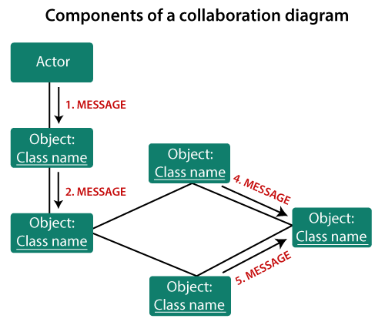
Collaboration Diagram
Purpose of Interaction Diagrams
To capture the dynamic behaviour of a system.
To describe the message flow in the system.
To describe the structural organization of the objects.
To describe the interaction among objects.

Slide 33
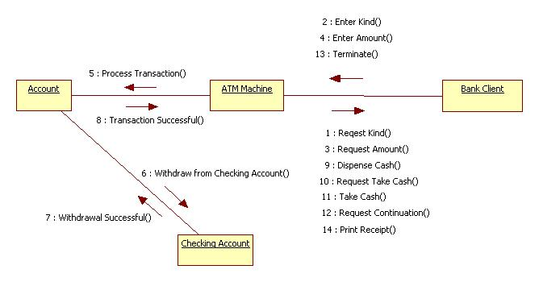
Example : ATM

Slide 34
Activity Diagram
Activity diagrams and use cases are logical model which describe the business domain’s activities without suggesting how they are conduct.
Shows the sequence of steps that make up a complex process.
Shows flow of control, similarly sequence diagram but focus on operations.
A diagram that emphasizes the flow of control from activity to activity in an object.
Similar to the traditional program flowchart.
Used to provide detail for complex algorithms.
Primary activities and the relationships among the activities in a process.

Slide 35

Activity Diagram
Purpose
To model a task (for example in business modelling)
To describe a function of a system represented by a use case
To describe the logic of an operation
To model the activities that make up the life cycle in the
Unified Process
Draw the activity flow of a system.
Describe the sequence from one activity to another.
Describe the parallel, branched and concurrent flow of the
system.
Activity Diagram Notations
Initial Node
This represents the start of the flow of an activity diagram.
An activity diagram contains a single start node.
The name of the initial node is entered on the node. It takes the form of an adjective.

Slide 36

Activity Diagram Notations
Control Flow
A control flow connects any combination of:
activities
branches
merges
forks
joins
A control flow has direction, which is indicated by the arrow head – you may only traverse the control flow in the direction of the arrow.
A control flow may not enter an initial state.
A control flow may not exit a final node.
A control flow is the representation of an occurrence of an event.

Slide 37
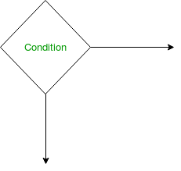
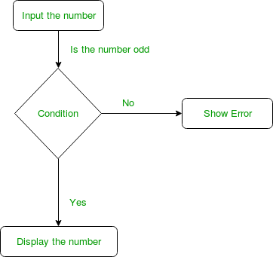

Activity Diagram Notations
Activity or Action
An activity represents execution of an action on objects or by objects. We represent an activity using a rectangle with rounded corners. Basically any action or event that takes place is represented using an activity.
Decision node and Branching
When we need to make a decision before deciding the flow of control, we use the decision node.

Slide 38
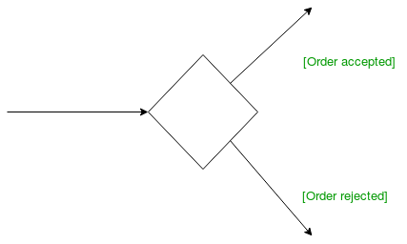
Activity Diagram Notations
Guards
A Guard refers to a statement written next to a decision node on an arrow sometimes within square brackets
The statement must be true for the control to shift along a particular direction. Guards help us know the constraints and conditions which determine the flow of a process.
Fork
The fork may be represented by vertical or horizontal bars.
The fork represents that the flow through the diagram has split into 2 paths that are running in parallel (multitasking).
The fork has a single control flow on entry and several control flows exiting.

Slide 39

Activity Diagram Notations
Join
For every fork there should be a join (if not your activity diagram is broken).
The join may be represented by vertical or horizontal bars.
A join simply shows that when the parallel activities have finished that they then come back to join a single flow again.
The join has several control flows entering and a single control flow on exit.
The exiting control flow cannot be executed until every incoming control flow has completed.
There is no need to label the fork or join.
Final State
The state which the system reaches when a particular process or activity ends is known as a Final State or End State. We use a filled circle within a circle notation to represent the final state in a state machine diagram

Slide 40
Activity Diagram Notations
START POINT
DECISION POINT
[Condition]
GUARD
END POINT
STEP
PARALLEL STEPS
TRANSITION
FORK AND JOIN

Slide 41
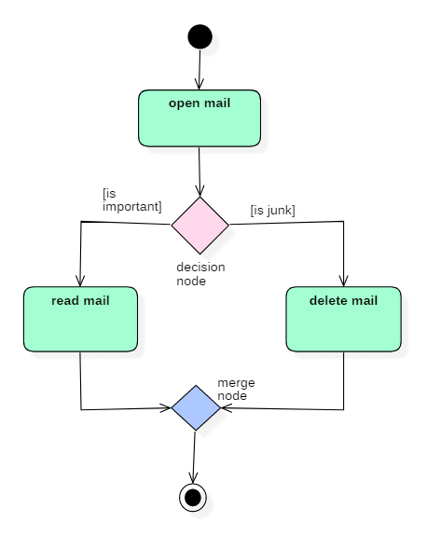
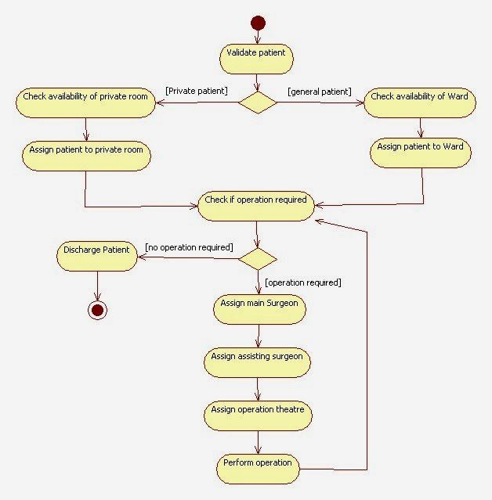
Example of Activity Diagram

Slide 42
State Diagram/State Machine/State chart
State model describes the sequences of operations that occur in response to external stimuli.
The state model consists of multiple state diagrams, one for each class with temporal behavior that is important to an application.
The state diagram is a standard computer science concept that relates events and states.
Events represent external stimuli and states represent values objects.
The basic elements of state diagrams are
Initial state – We use a black filled circle represent the initial state of a System or a class.
Events – An event is an occurrence at a point in time
states – the state in which the object finds itself at any moment
transitions – take the object from one state to another
actions – take place as a result of a transition
Final state – We use a filled circle within a circle notation to represent the final state in a state machine diagram.

Slide 43
State chart Diagram
Events
An event is an occurrence at a point in time such as –
User presses left button
Indigo flight departs from Mumbai
An event happens instantaneously with regard to time scale of an application.
Types of Events
Signal event
Time event
Change event

Slide 44
State chart Diagram
Signal Event
A signal is an explicit one-way transmission of information from one object to another.
An object sending a signal to another object may expect a reply, but the reply is a separate signal under the control of the second object, which may or may not choose to send it.
Time Event
Time event is an event caused by the occurrence of an absolute time or the elapse of a time interval.
UML notation for an absolute time is the keyword when followed by a parenthesized expression involving time.
when (date = Aug 1 , 2015 )
Change Event
A change event occurs whenever a specified condition is met
Event name is specified as keyword when
Parameter list is a Boolean expression
when (battery power < lower limit )
when (tire pressure < minimum pressure )

Slide 45
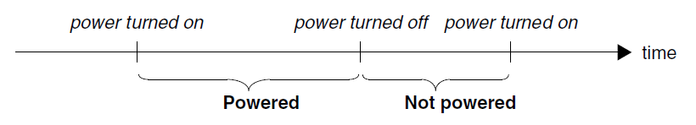

State chart Diagram
States
State is a condition or situation during the life of an object within which it performs some activity, or waits for some events
The objects in a class have a finite number of possible states.
Each object can be in one state at a time.
A state specifies the response of an object to input events.
At any given point in time, the system is in one state.
It will remain in this state until an event occurs that causes it to change state.
A state is when a system is:
Doing something – e.g., heating oven, mixing ingredients, accelerating engine,
Waiting for something to happen – Waiting for user to enter password, waiting for sensor reading
Event vs. state
Events represent points in time; states represent intervals of time.

Slide 46
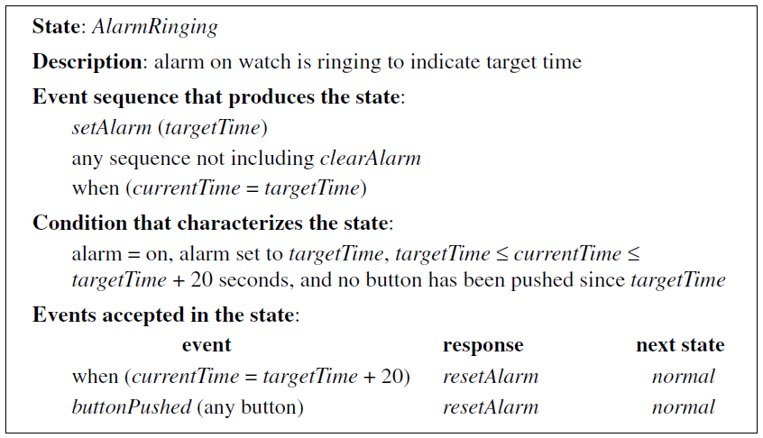
Various characterizations of a state. A state specifies the response of an object to input events.

Slide 47
Transitions
A transition is a relationship between two states indicating that an object in the first state will enter the second state.
A transition is an instantaneous change from one state to another.
The transition is said to fire upon the change from the source state to target state.
A guard condition must be true in order for a transition to occur.
A guard condition is checked only once, at the time the event occurs, and the transition fires if the condition is true.
A directed relationship between two states.
Source state - current state before transition fires.
Event trigger - external stimulus that has the potential to cause a transition to fire.
Guard condition - a condition that must be satisfied before a transition can fire.
Target state - new state after transition fires.

Slide 48
A transition is drawn with an arrow, possibly labeled with
event causing the transaction
guard condition
Action to perform
event
action
off hook / play dial tone
Idle
[ valid subscriber ]
Active
on hook
guard condition

Slide 49
Actions
is an executable atomic computation
includes operation calls, the creation or destruction of another object, or the sending of a signal to an object
Initial State
Transition
Idle
Running
State
Unpaid
Paid
Invoice created
paying
Invoice destroying

Slide 50
State Diagrams notation
Initial state
event
final state
name
Invoice created
Invoice destroyed
paying
Unpaid
Paid
transition
state

Slide 51
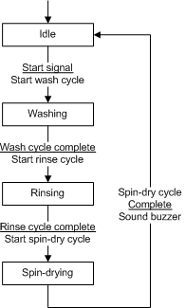

Example: Here’s a simple example SD for a washing machine
State
Transition
Condition
Action

Slide 52
Seminar Registration

Slide 53
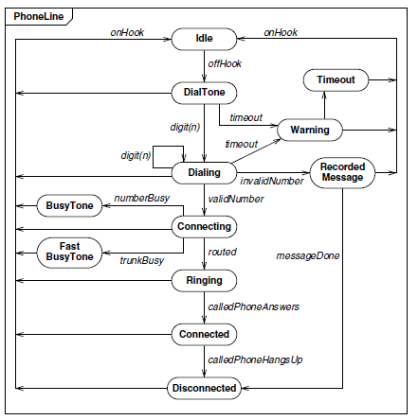
State diagram for a telephone line

Slide 54
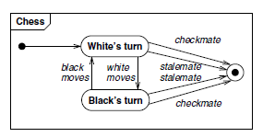
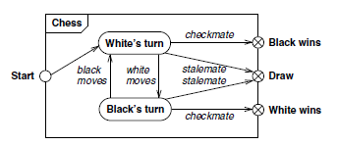
State diagram for chess game

Slide 55
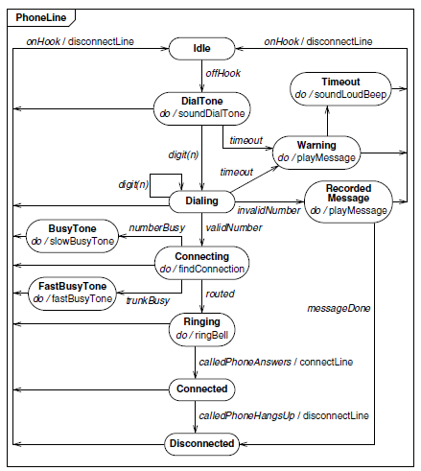
State diagram for phone line with activities

Slide 56
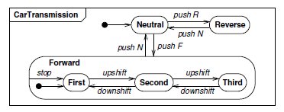
Nested State Diagrams
You can structure states more deeply than just replacing a state with a submachine.

Slide 57


